Slide 1
Test types
VLC: Desktop media player
Volodymyr Prudnikov-Roshko
January 2016

Slide 2

Object:
VLC media player

Slide 3

Agenda
- Smoke testing
- Functional testing
- Positive testing
- Integration testing
- Non-functional testing: UI
- Performance testing
- Load testing
- Stress testing

Slide 4
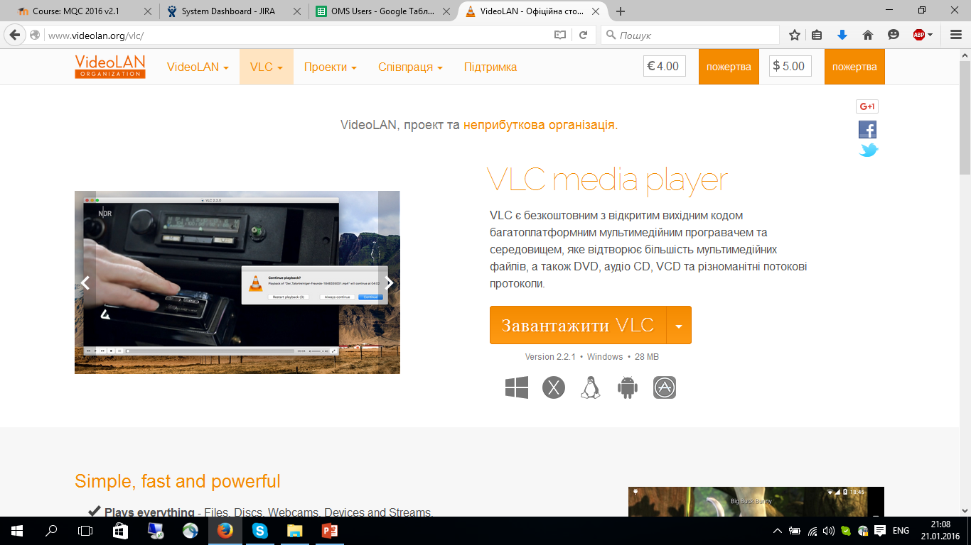
Smoke testing
Requirement: As a User, I want to own VLC media player program, so than I can download it.
Smoke Testing Procedure:
1. Open URL: http://videolan.org/vlc/
Expected result:
The Page is opened.

Slide 5
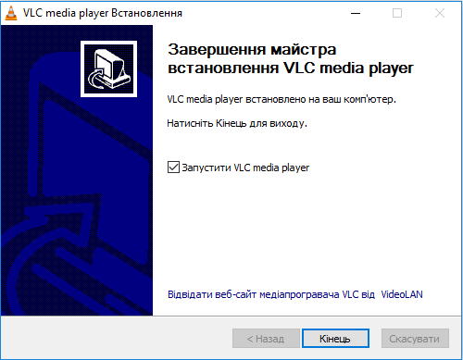
Functional testing
Requirement: As a User, I want to install VLC media player, so that I can get experience working with VLC.
Functional Testing Procedure:
1. Open URL: http://www.videolan.org/vlc/
2. Click “Download button”
3. Run downloaded application
4. Pass all steps that installation
program needed
Expected result:
VLC media player being
installed on the PC.

Slide 6
Positive testing
Requirement: As a User, I want to have a possibility to open the video files via VLC media player.
Positive Testing Procedure:
1. Open VLC media player
2. Press “Media” menu button
3. Press “Open file”
4. Find the video file and press “Open” button
Expected result:
The video file starts playing

Slide 7
Integration testing
Requirement: As a User I need to have a possibility to change an audio track while video plays.
Integration Testing Procedure:
1. Open VLC media player
2. Click “Media” -> “Open file”
3. Find the file
4. Press “Open” button
5. While video is playing, press “Audio” -> “Audio track” -> different audio track
Expected result:
Audio track will changes.

Slide 8
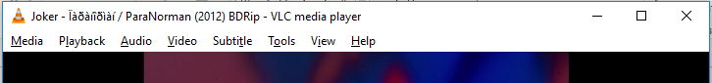
Non-functional testing: UI
Requirements: As a User I need the Menu, so that I can navigate through the application.
UI Testing Procedure:
1. Open the VLC media player
2. Observe the top side of the program for a menu bar
Expected result:
The Menu is located in the top side of the VLC media player.
The menu bar consists of “Media”, “Playback”, “Audio”, “Video”, “Subtitle”, “Tools”, “View” and “Help” items.

Slide 9
Performance testing
Requirement: As a User I want to have respond from the software in less than 5 sec after opening a video file which size is more than 1 Gb.
Performance Testing Procedure:
1. Open VLC media player
2. Click “Media” -> “Open file”
3. Find the video file
4. Press “Open” button
5. Measure spent time in seconds
Expected result:
The system responds in less than 5 sec.

Slide 10
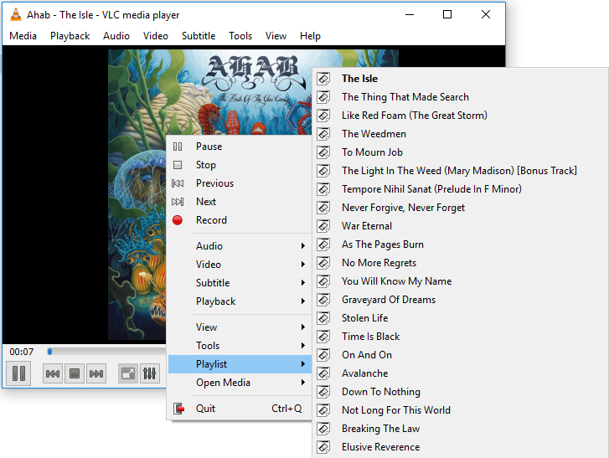
Load testing
Requirement: As a software I need to support the playlist which will contain more than 100 items inside.
Load Testing Procedure:
1. Open VLC media player
2. Click “Media” -> “Open file”
3. Find the video files
4. Click by left mouse button
on random file
5. Press “Ctrl+A” combination
on the keyboard
5. Press “Open” button
Expected result:
100 items puts into playlist

Slide 11
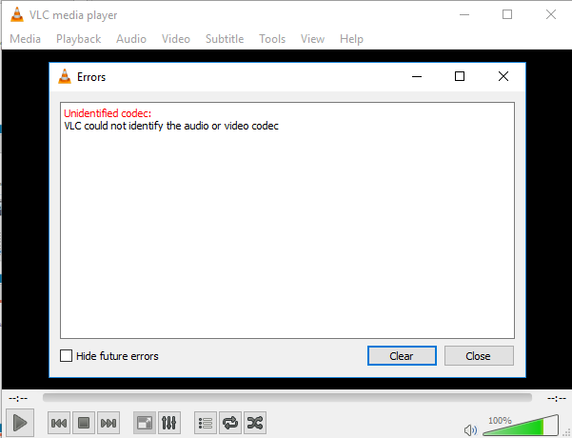
Stress testing
Requirement: As a software I need to open only media files.
Stress Testing Procedure:
1. Open VLC media player
2. Click “Media” -> “Open file”
On the dropdown list of file
Types select “All files”
4. Find some non-media file
5. Press “Open” button
Result:
An error message that VLC
couldn’t identify the audio
or video codec

Slide 12
Thank you
US OFFICES
Austin, TX
Fort Myers, FL
Boston, MA
Newport Beach, CA
Salt Lake City, UT
EUROPE OFFICES
United Kingdom
Germany
The Netherlands
Ukraine
Bulgaria
EMAIL
info@softserveinc.com
WEBSITE:
www.softserveinc.com
USA TELEPHONE
Toll-Free: 866.687.3588
Office: 239.690.3111
UK TELEPHONE
Tel: 0207.544.8414
GERMAN TELEPHONE
Tel: 0692.602.5857

